Slide 1
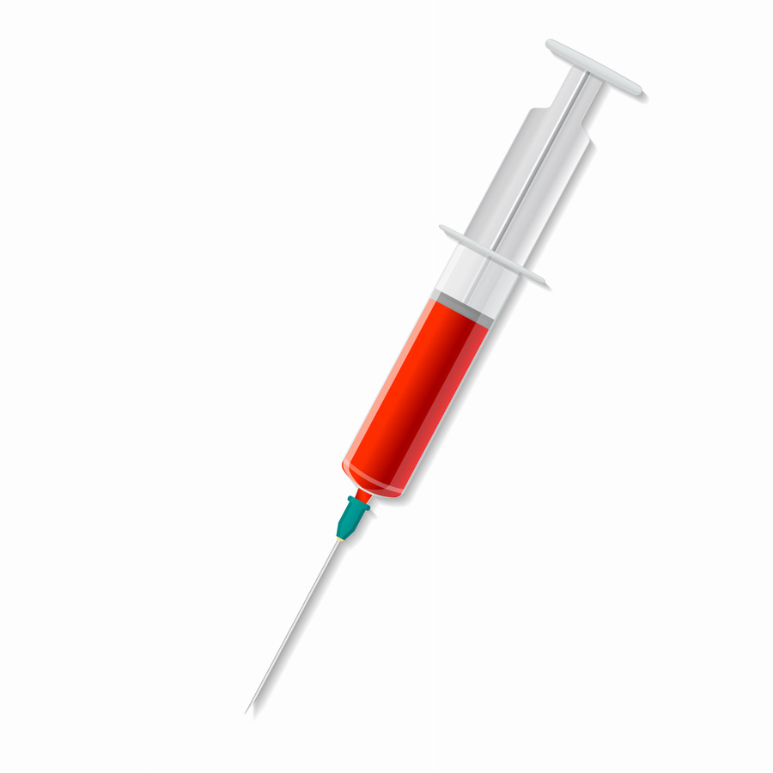
Phlebotomy Program
Spring 2024 – Del Norte
Adult and Community Education
Program Director: Jim Gordon
Instructor: Roxanne Garman

Slide 2
Welcome and Introductions

Slide 3
Agenda
What phlebotomy is and what it is not
What are the state requirements?
Course information, dates and format
Cost and funding options
Applicarion process

Slide 4
What’s a Phlebotomist?
Practices in hospitals, clinics and freestanding labs
Direct patient contact/care
Responsible for blood draws (venipuncture) and collections
Does not administer medications or initiate IV access

Slide 5
What makes a good Phlebotomist?
Patience!
Empathy
Critical thinking skills
Communication skills
People skills

Slide 6
About the course..
Not-for-Credit Program
Nationally recognized certification exam is included (NHA)
Class includes:
Phlebotomy class
Basic CPR
Textbooks, handouts, and online NHA test prep
Materials and supplies for laboratory portions of the class
Clinical rotation in a healthcare facility
Job Prep (resume, cover letter, interviewing)

Slide 7
Class Dates and Format
Dates: January 13, 2024 – April 20, 2024
14 in person didactic/lab sessions – includes 2 makeup days
Days: Saturdays
Time: 9:00AM – 4:30PM (1/2 hour lunch)
Location: CR Del Norte Education Center
Certification Exam
May 4th, 2024 at 10am – online in computer lab
Sign up information will be provided in class

Slide 8
Clinical Externship Entrance Requirements
Healthcare requirements are subject to the requirements of the clinical site and CR’s policies and are subject to change.
ALL Requirements must be met by January 7, 2023
Physical Exam
The following will be due on the First Day of Class:
Background Check through Castle Branch Approximately $35.
Signed Disclosure Statements
Immunizations Records – No Exceptions!
You cannot enter the clinical portion of the class unless you submitted proof of all the required immunizations and all documentation has been signed and approved.

Slide 9
Immunizations Costs and Guidelines
You must have the majority of these on the first day of class!!
Immunization or Titer | Appro. Cost*
COVID, Moderna – 2 doses plus booster (prior to 2023) COVID, Pfizer – 2 doses plus booster (prior to 2023) COVID, J&J - 1 dose plus booster (prior to 2023) COVID, (2023- present) 1 dose | Free
Flu - current season (annually, August – April) – 1 dose | Free
Hepatitis B – (option 1) Hepislav, 2 doses
Hepatitis B – (option 2) Energix / Recombivax, 3 doses 4 weeks between 1st two doses, 8 weeks between dose 2 & 3, but 16 weeks between dose 1 & 3
Measles – 2 doses, 4 weeks between doses Mumps - 2 doses, 4 weeks between doses Rubella - 2 doses, 4 weeks between doses
TB - PPD – 2 Negative tests or 1 QuantiFERON test – no more than 3 months old | Unknown
TDAP – 1 dose | Unknown
Varicella/Chicken Pox – 2 doses – 4 weeks apart | $129

Slide 10
Immunization Information
Immunizations are absolutely required – no exceptions!
Can be obtained through your doctor, a pharmacy or at
Public Health Clinic –
If you already have these you do not have to get again
You will need to submit your immunization record on the first class day.
If you think you already had these or had the illness you can get a Titer:
This will show that you have the antibodies
You will need to submit these results to our office

Slide 11
Clinical Externship
Performed at a local healthcare facility
Program Director must place you and will make every attempt to place you in your preferred clinical location.
Once placed, we will mail your blue clinical folder. This will be used to record the following: 40 hours and 50 successful venipunctures. (10 Dermals & 2 Arterial Blood gas observations – TBD where).
It will be the responsibility of the student to keep track of this folder and submit it to the ACE office upon completion

Slide 12
Requirements to apply for CPT 1 License
HS grad or equivalent
Background check
Complete an approved certification program (like this one)
Pass the National Healthcareer Association Certified Phlebotomy Technician exam
Complete a 40 hour Clinical Externship
Must submit application to the Department of Public Health with required fee

Slide 13
Health and Safety
Class size limited to 18 at this time
PPE available
“If you’re sick, stay home!”
Notify your instructor, AND email the Adult and Community Education Office
ace@redwoods.edu

Slide 14
Costs
Class Fee: $1,995.00
Other costs* (approximate):
Background Check - $35-$40
Immunizations - $200 - $300
Official, Sealed Transcripts (send directly to CDPH)
CPT 1 License Fee - Approximately $100

Slide 15
Payment options
There are three (3) ways to pay for the class:
Student pays personally with Cash, Check or Credit/Debit Card
Nelnet Payment Plan
Student is sponsored by an agency
AJCC – America’s Job Centers of CA
Department of Rehabilitation
Native American Tribes
Many people assume they are sponsored when in fact they are not. We cannot hold seats until we have sponsorship authorization.

Slide 16
Funding Sources
Job Market – Humboldt Workforce Coalition
409 K Street, Eureka
Del Norte SMART Workforce Center
875 5th Street, Crescent City, 707-464-8347
Department of Rehabilitation
1330 Bayshore Way, Suite 101, Eureka, 707-445-6300
Native Tribes – NCIDC or Tribal Education office
Public Assistance – If you are receiving TANF, Welfare to Work, Cal Works, Cal Fresh, Etc., talk to your case worker to see what is possible.
Worker’s Compensation
Family/Friends – People tend to be willing to pay for education.

Slide 17
Nelnet Payment Plan
Class | Phlebotomy Payment Plan
Total Cost | $1,995
Down Payment | Option 1: $1,000 & $20 Payment Plan Fee Due upon registration Option 2: $500 & $20 Payment Plan Fee Due upon registration
Monthly Payment Amount | Option 1: Approximately $332 for 3 months Option 2: Approximately $500 for 3 months
Payment plans are to be processed with a Debit/Credit card only!
Payment plans are available through Nelnet.
There is a $20 payment plan fee.
Payment plans must be set up when you register for class.
If you choose to set up a payment plan your Certificate of Completion will be issued upon completion of your payment plan.
All payments must be complete prior to being allowed to take the NCCT exam.

Slide 18
Applucation Process
Applicants will be selected by random lottery
First 18 drawn will receive acceptance letters
Remaining applicants will receive waitlist letters and their # (ex. 7 of 23)
Application will be loaded to the Phlebotomy – Del Norte website by 1pm today
Application period closes November 17, 2023 at 12pm
Photos of applications will not be accepted!
Applications can be mailed, emailed or faxed
Mail: Adult and Community Education
525 D Street
Eureka, CA 95501
Email: ace@redwoods.edu
Fax: 707-443-3417
Payment is due at time of registration or must include a sponsorship letter
The following needs to be submitted for registration
Registration Form
Release of Information
Payment or sponsorship letter

Slide 19
Application Process – part 2
All letters will be mailed out no later than November 21
Accepted students will receive:
Letter
Registration form
Background check info
Immunization info / checklist
Transcript info for CPDH
Registration form and payment arrangement need to be made as soon as possible
Deadline to register is December 21st, 2023
Waitlisted students will receive:
Letter
Background check info
Immunization info / checklist
If a seat becomes available, we will call you.
Please make sure your phone # is listed correctly, and your voicemail is not full!

Slide 20
Questions????
Email: ACE@redwoods.edu
Phone: 707-476-4500
Address: 525 D Street Eureka, CA 95501
Application and supporting documents will be
uploaded by 1pm today

