Slide 1
Caring Campus CR Cares Presentation to the Board of Trustees​
College Of The Redwoods
June 4, 2024
Matthew Gilliland, Veterans Resource Center Coordinator
Gussie Solem, Career Education Coordinator
CR Cares Co-Chairs

Slide 2
What is Caring Campus?
Caring Campus (CR Cares) is a program developed by the Institute for Evidence-Based Change (IEBC) to create a culture of caring at community colleges.
A supportive network for classified staff that expands our bandwidth and ability to support students.
Monthly hybrid meetings with multiple sub-committees working to implement our behavioral commitments.

Slide 3
CR Cares Behavioral Commitments
Cross-Departmental Awareness
Ten Foot Rule
Nametags
Welcoming Students
Warm Referrals

Slide 4
Milestones & Accomplishments
Parking warning card with resources
Caught in the Act of Caring Flyers
Nametag form and process
CR Cares Newsletters
CR Cares Representation attending the State Classified Leadership Institute

Slide 5
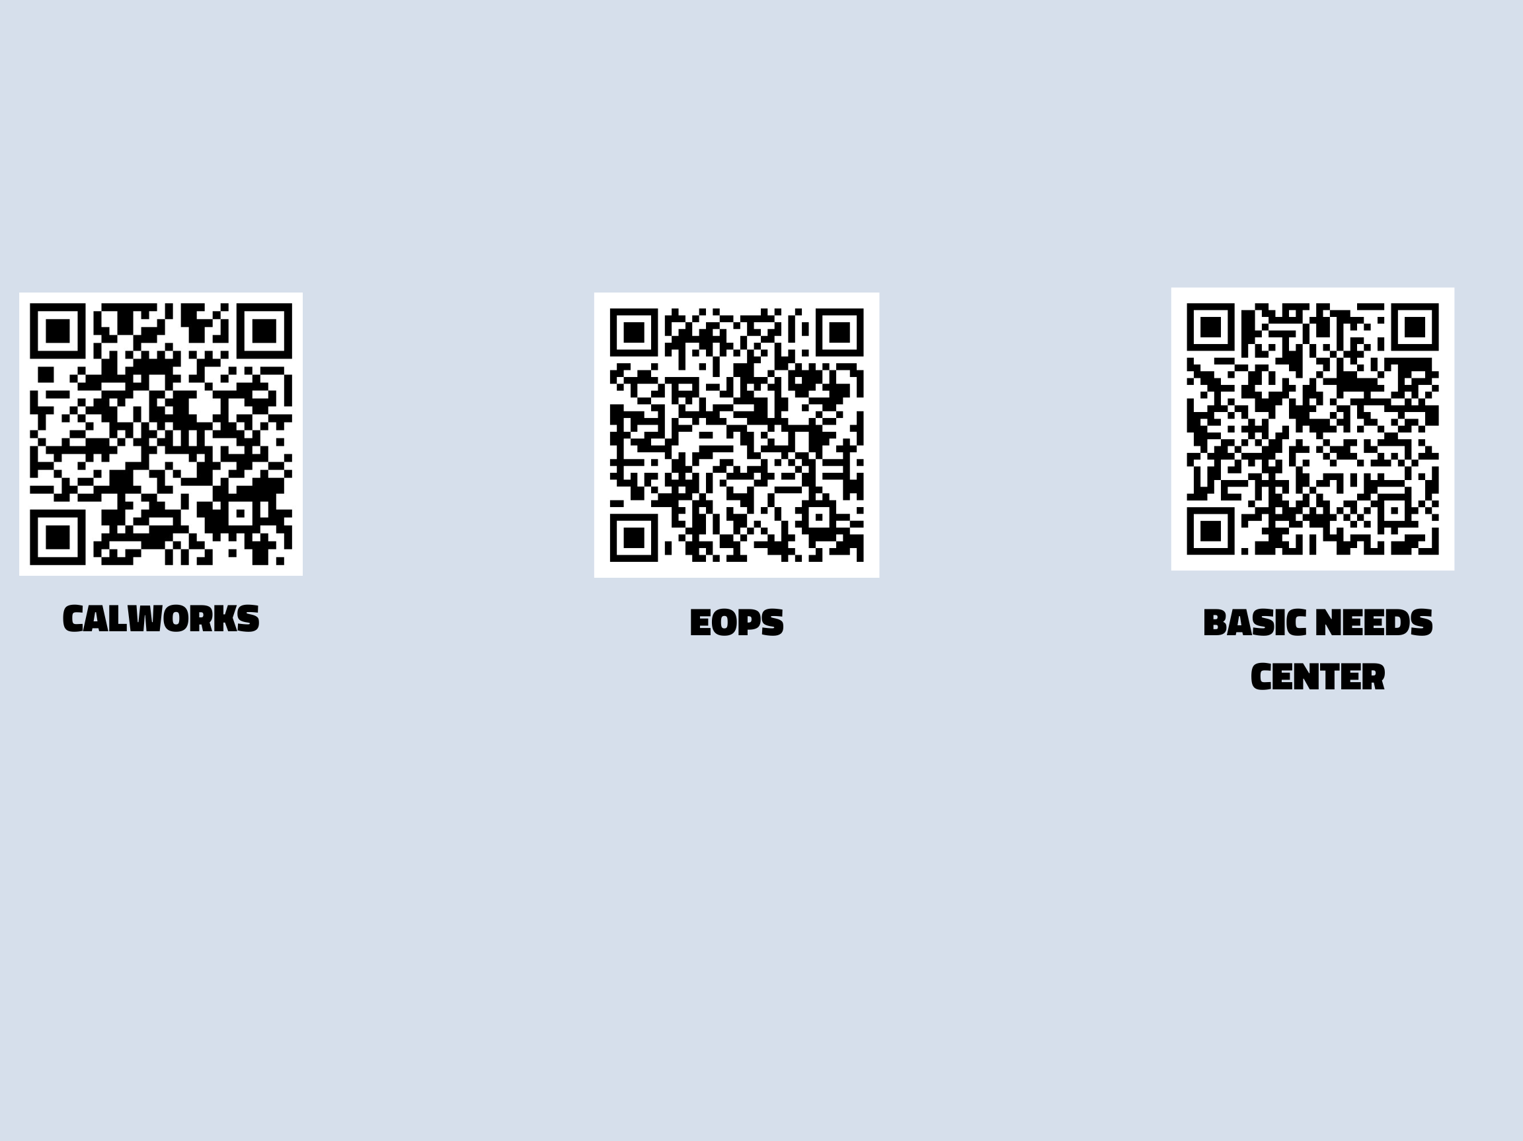
Milestones & Accomplishments
Parking warning card with resources

Slide 6
Milestones & Accomplishments
Caught in the act of caring flyer

Slide 7
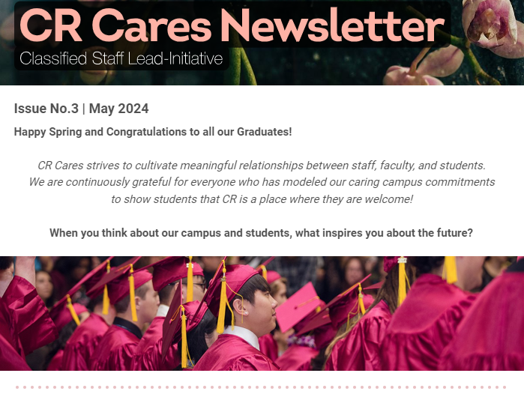
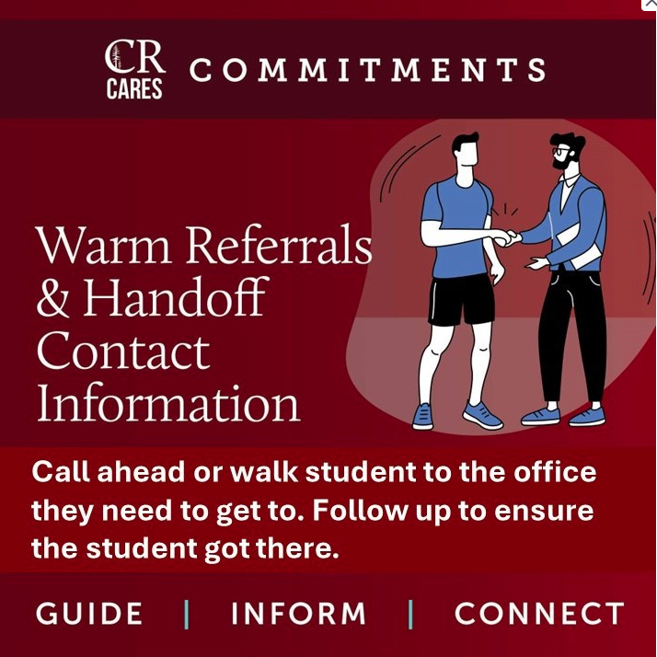
Milestones & Accomplishments

Slide 8
Behavioral Commitments & the Education Master Plan
Initiative 3: Create a more nimble and adaptable institution
CR planning process with representation from all departments and campuses.
Our meetings actively promote heterodoxy and thinking outside the box.
Identify known & unknown gaps and brainstorm ways to address them.

Slide 9
Behavioral Commitments & the Education Master Plan
Initiative 3: Create a more nimble and adaptable institution
Serves as an interdisciplinary space to consider possibilities for making improvements for CR as a district.
Supported by the CR Cares leadership and administrative liaison who helps move ideas forward through the appropriate channels.

Slide 10
Behavioral Commitments & the Education Master Plan
Initiative 4: Establish stronger wraparound experiences for students’ total connection
Help students develop a web of connections by initiating it.
Identify ourselves so that students will know who to approach with questions.
Fostering an environment in which students can thrive.

Slide 11
Caring Campus CR Cares
CR-Cares@Redwoods.edu

