Slide 1
Supporting Underrepresented Students in STEM
Helping students create a Science Identity

Slide 2
Underrepresented Students in STEM
Latinx and Black students remain underrepresented in STEM, compared with their share in the population, and a smaller share are earning degrees in a STEM fields than in other degree programs.
(Fry et al., 2021) https://www.pewresearch.org/science/2021/04/01/stem-jobs-see-uneven-progress-in-increasing-gender-racial-and-ethnic-diversity/

Slide 3
Identity Matters
Latinx, African American and Native American students report that their ethnic identities are very important them.
A strong ethnic identity is correlated with positive success rates in academics.

Slide 4
Women and Varied Representation
The representation of women varies widely across STEM fields. Women make up a large majority of all students in health related fields but are underrepresented in math, physical sciences, computing and engineering. This pattern is consistent throughout colleges (Fry et al., 2021).

Slide 5
Differently Abled Students
Data on disability are difficult to obtain for many reasons in research addressing representation for reasons of confidentiality and privacy.
This group of students is included as an underrepresented population in STEM for purposes of this presentation.

Slide 6
Two important predictors of success in science education.
Science Identity and Science Efficacy
The capacity for envisioning and experiencing oneself as capable of stepping into a career in STEM is critical to future success (Hurtado, et. al, 2016).
Without a sense of ability or efficacy, students will not have the psychological support to continue to follow through on goals or even begin the process of reaching these goals (Bandura, 1997; Hurtado et. al, 2009).

Slide 7
Science Identity is Developed in a Social Context.

Slide 8
Strong Science Identity increases retention and success in the sciences.

Slide 9
STEM persistence may be negatively affected if a person is not given an opportunity to develop their STEM identity.

Slide 10
How can Science Identity be fostered in and outside of the classroom?

Slide 11
1. Creating Research and Hands on Opportunities Early the First Year (Ungraded and group work is best).
2. Creating Mentorship Opportunities.
3. Providing Meaningful Examples for Role Models of Success in the Science Fields.
4. Multicultural Curriculum.
5. Teaching Science through Social Justice.

Slide 12
Inclusion

Slide 13
Research/Hands On Assignments
Science Efficacy is Performative
Set students up for success
Ungraded
Jigsaw groups
The first few weeks of the semester

Slide 14
Mentoring
Mentoring increases both Science Identity and Efficacy. A guiding person with science currency will have tremendous impacts on those developing a new identity.
Meeting students where they are at with an approach of listening, sharing histories, non-competitive communication, can positively changes lives.
Partnerships across units create mentoring possibilities. Mentors inside and outside the classroom are essential to developing academic identities.
Can be formal or informal.

Slide 15
Mentoring can be informal
Informal mentoring is about sharing experiences, listening, and helping students connect to their own emotional intelligence. It does not always require a lot of time but it does require quality communications to show students that it is possible for them to reach their goals and that there are supports to help them overcome challenges.
Identity Research:
Acknowledging the multiple identities students bring to the college experience is very important to both Latinx and Black students. A strong cultural identity is associated with higher graduation rates in these groups.

Slide 16
Mentoring can be formal
There are many formal mentoring programs that are often grant funded at community colleges.
Examples of Formal Mentoring Programs:
https://www.communitycollegereview.com/blog/mentoring-at-community-college-helping-students-succeed

Slide 17
Sharing History and Deep Culture
Provide structured opportunities to share your own story and open the door for students to discuss their own identities, while giving permission to students not to offer any information the are uncomfortable with. First answer the questions yourself. This way students can see that their whole selves are brought to the classroom experience.
Conocimiento
What languages are spoken in your home or the one you grew up in?
Where were you born and what would you consider your home-town?
Where did your great-grandparents come from?
What holidays do you celebrate?
Did you have a rite of passage as a young adult?
How many siblings do you have, if any, and what is your birth order?
Do you know the meaning of your name?
What are your academic goals?
If you could pick anyone in the world you would like to be, besides you, who would that be?
What obstacles to you face as a student?
Are you a parent?
Do you work and go to school?
Please share one thing about yourself, that feels comfortable to share with others, that is not obvious when someone first meets you.

Slide 18
Diversity

Slide 19
Negative stereotypes develop when there is an absence of role models who reflect underrepresented students.
Students internalize these negative stereotypes, and subsequently believe that science is not a place where they can find success.

Slide 20
Discussing and Displaying Role Models that are representative of all Student Populations can foster New Visions of Success.

Slide 21
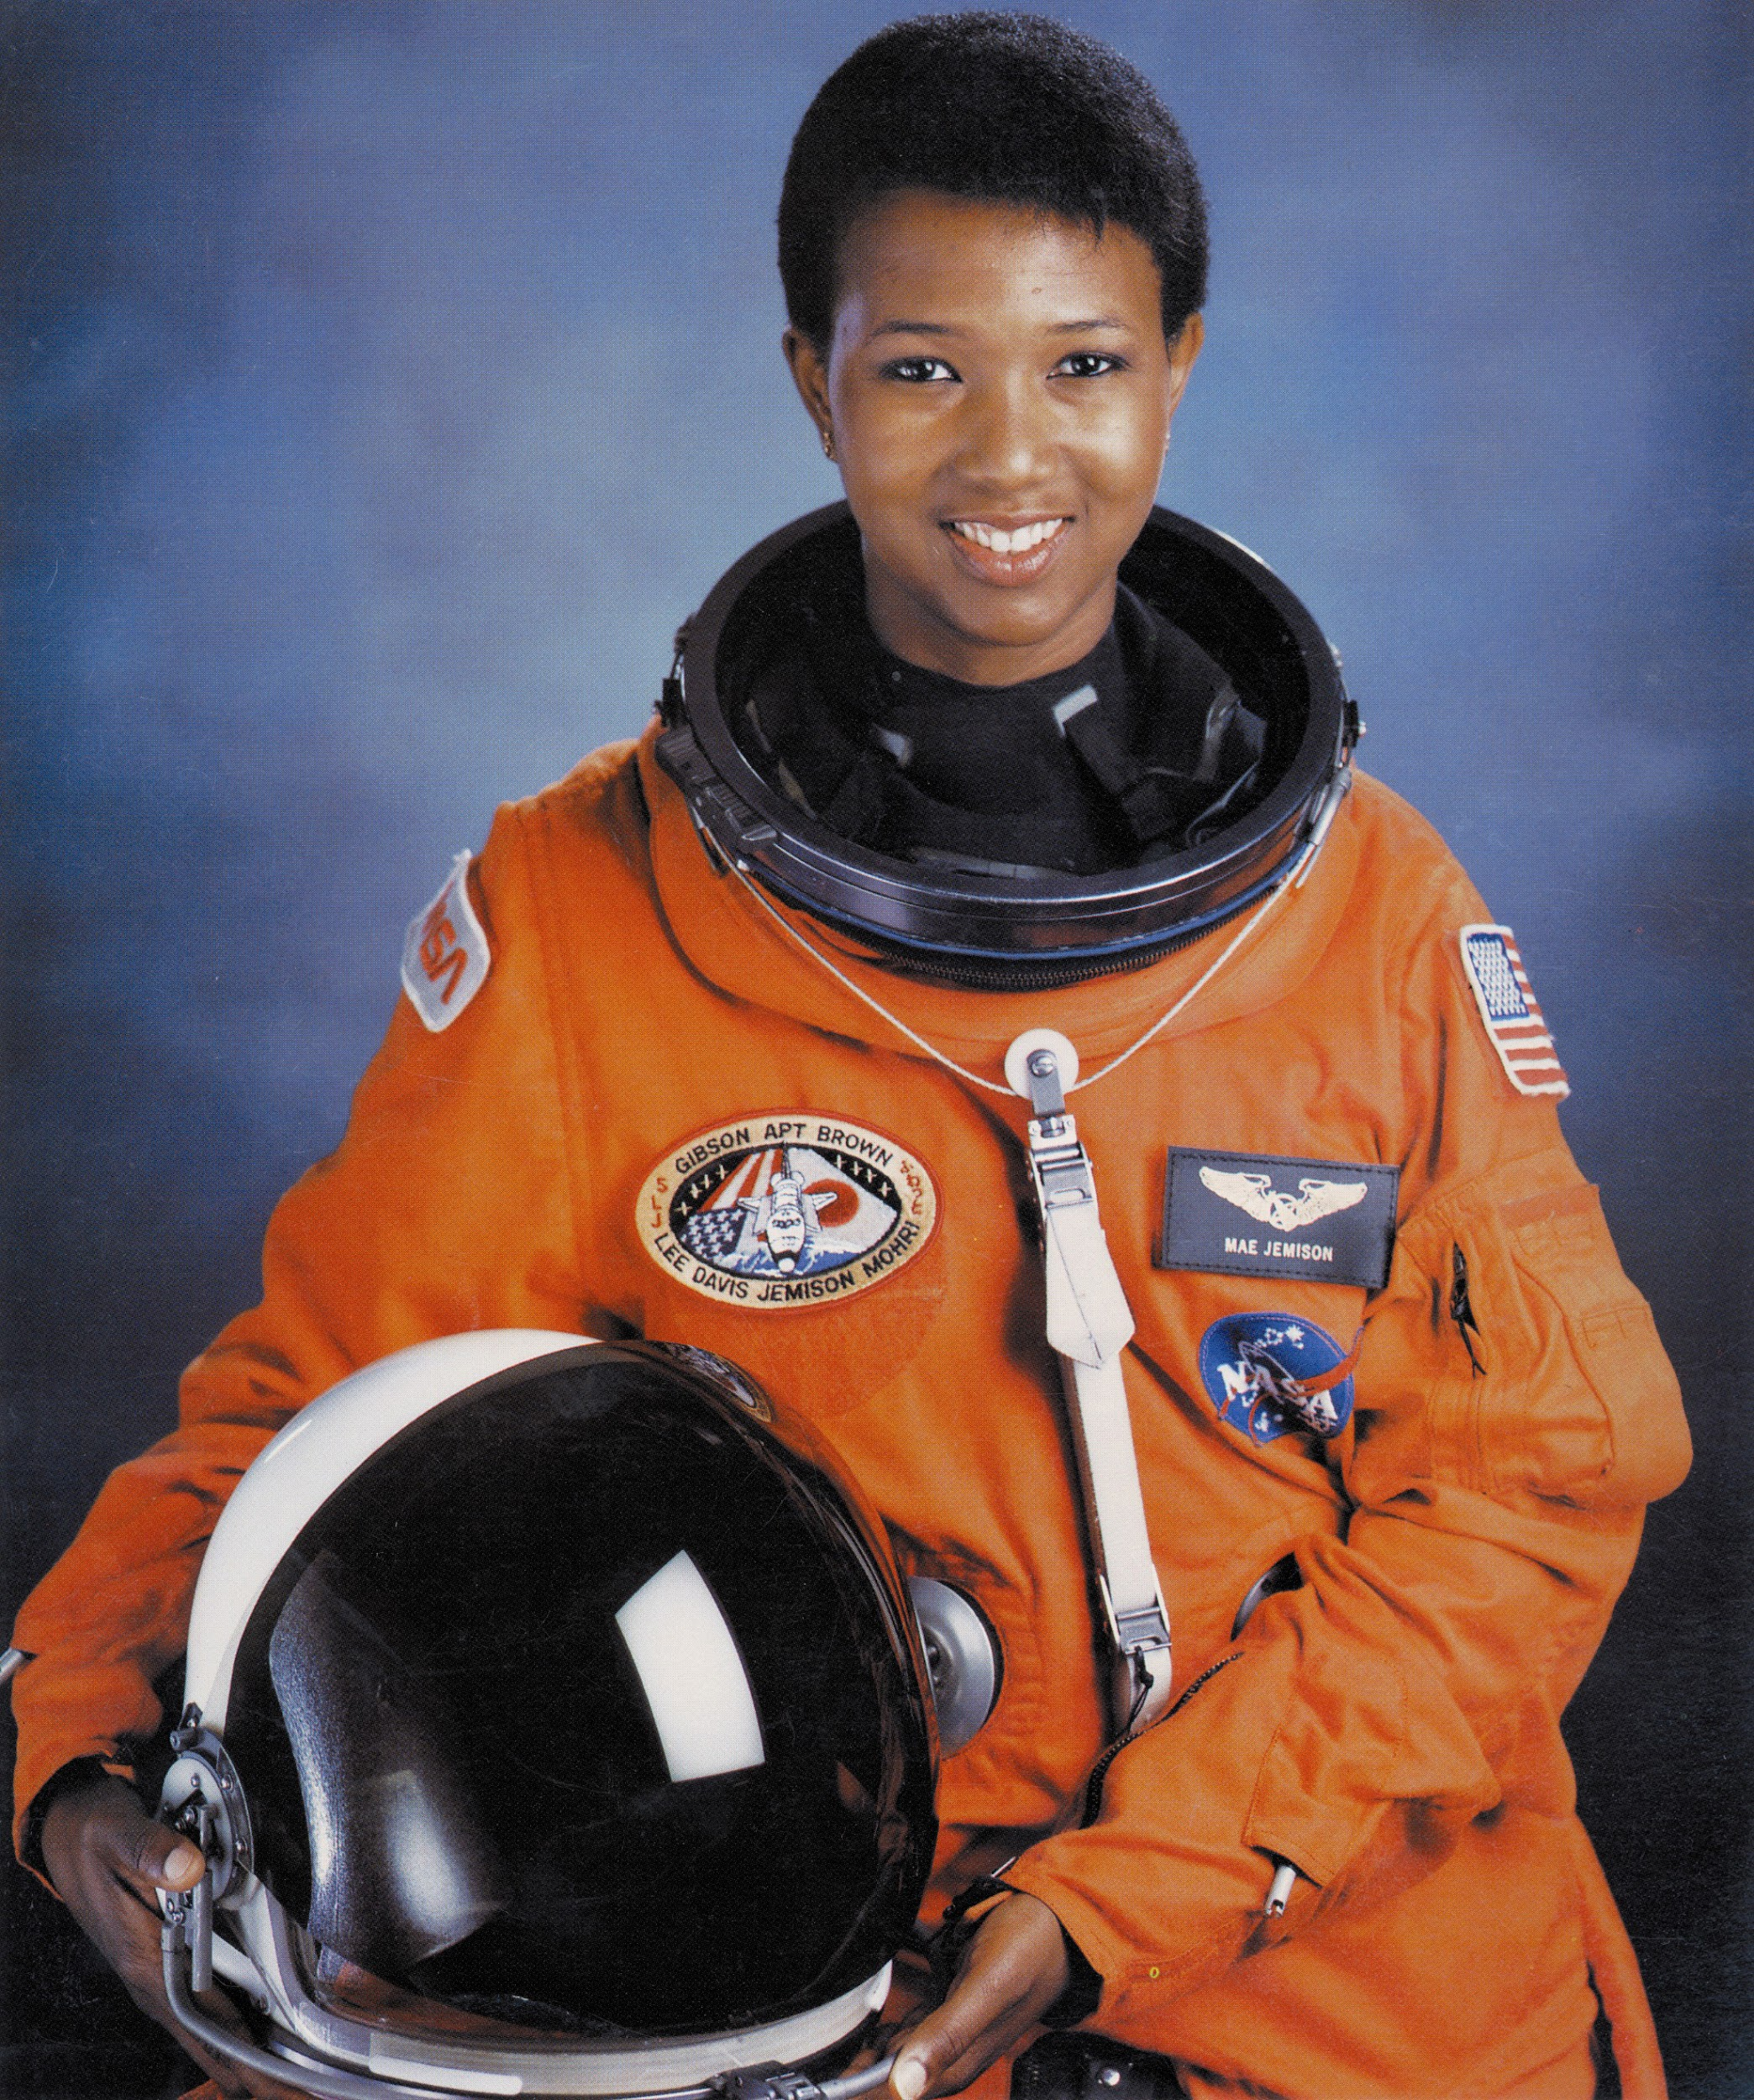
Mae Jemison
Chemical Engineer, Medical Doctor and Astronaut!

Slide 22
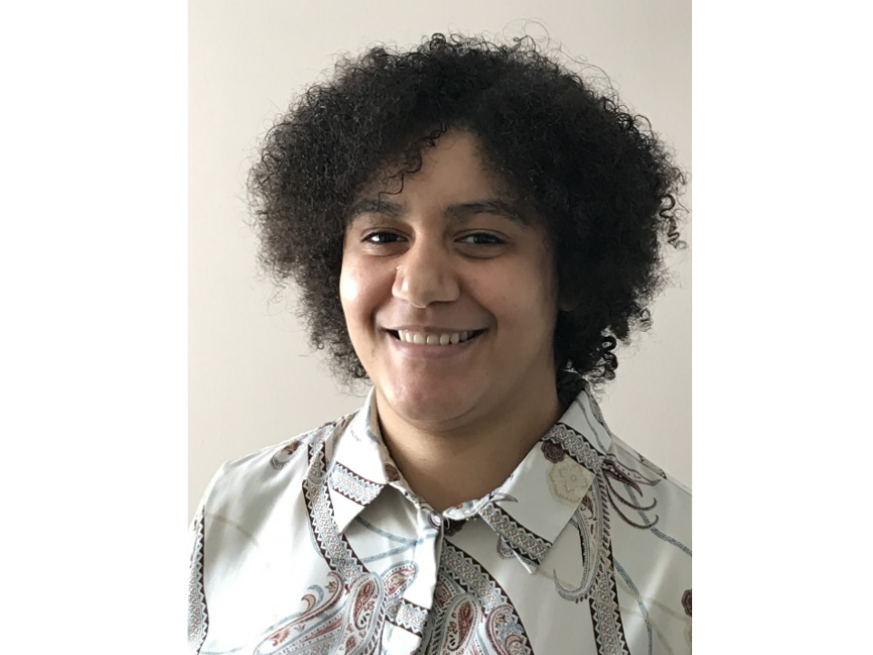
Jazmine Scarlett Lives with Rheumatoid Arthritis and is a Volcanologist

Slide 23
Dr. Scarlett became fascinated by her family heritage and their experiences with volcanic behavior on the Grenadines. She then used her research to inform communities impacted by volcanoes.

Slide 24
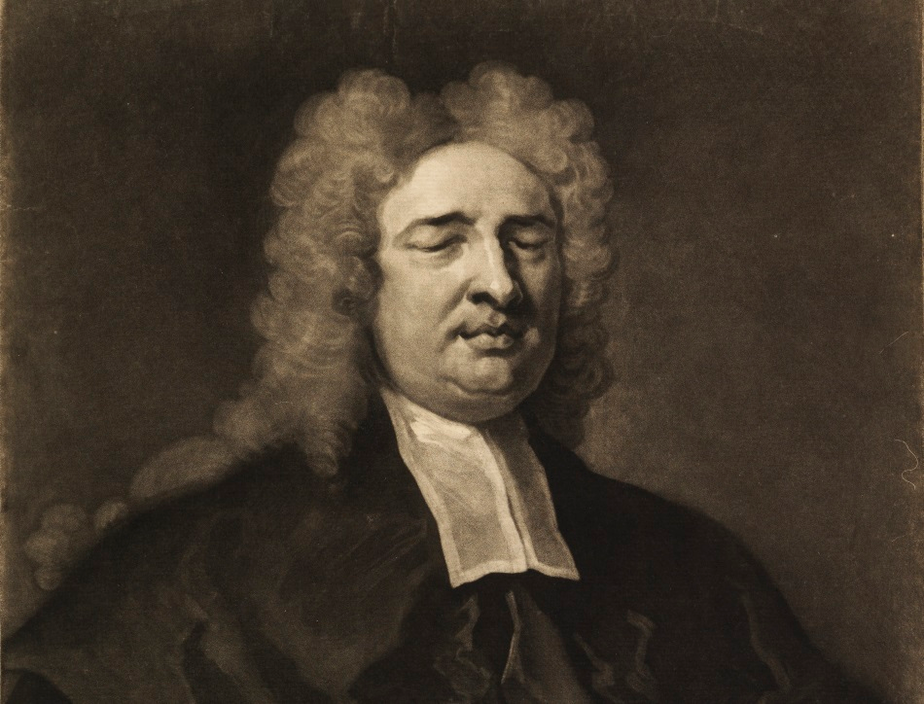
Image of Nicholas Sanders Mathematician and Scientist: Inventor of Braille

Slide 25
I
Instructors can carefully weave subject matter with activities and images within relevant contexts that validate contributions of individuals from diverse cultural backgrounds.
Superficial mention of diverse scientists in limited contexts can create perceived marginalization of role models.

Slide 26
Two TedTalks that both represent Different Forms of Reality Teaching with two Caveats

Slide 27
Be cautious of cultural appropriations while allowing students to express their own cultural identities in ways that make sense to them.

Slide 28
Being authentic means using your strengths in making connections.

Slide 29
Christopher Emdin Reality Teaching in STEM https://www.youtube.com/watch?v=2Y9tVf_8fqo

Slide 30
Kyle Reyes https://www.youtube.com/watch?v=mezisbD7HIw

Slide 31
Equity

Slide 32
Include Social Justice and Cross-Cultural Perspectives.
Include alternate models of scientific understanding from cross-cultural perspectives.
Example: Compare your own beliefs about what science is with science by the World Indigenous Science Network How are Western science and Indigenous science similar? Different?

Slide 34
Multicultural Curriculum in STEM
Multicultural Curriculum encourages engagement by allowing for opportunities for students to find themselves in course material.
The first job of multicultural scholars was to dispel the myths that STEM curricula was culturally-neutral or value-free (Hinant-Crawford, 2016).
In mathematics, d’Ambrosio (2001, p. 310) explains, “Children are seldom taught that several ancient Greek mathematicians, for instance Pythagoras and Thales […] traveled and studied in such places as India and northern Africa”.
Similarly, ethnocomputing scholars argue that the foundations of computing have existed for millennia and attest “Even the word ‘algorithm’ was derived from the name of the noted Persian mathematician Mohammed ibn-Musa al-Khwarizmi” (Tedre et al., 2006, p. 127).

Slide 35
Teaching Social Justice through Science
Openly discuss the WEIRD issue with students, Science education in the U.S. has often centered on Western, Educated, Industrialized, Rich, and Democratic —and mostly on the work of white men recognized as scientists in society (Heinrich, 2008)

Slide 36
Summary
Provide students with opportunities to develop Science Identity and Science Efficacy.
Engage students right away in research activities that are not graded using jigsaw methods. Set them up to succeed.
FieldInstructiontps://nagt.org/nagt/teaching_resources/teachingmaterials/15942.html
Provide Role Models of Success contextualized in history and contributions.
Partner with all college units to provide conditions for Mentoring Relationships to develop.

Slide 37
Summary Continued
Create Multicultural Curriculum
https://www.radicalmath.org/curriculum
http://www.nameorg.org/learn/can_i_be_a_multicultural_educa.php
Teach Social Justice through Math & Science
file:///C:/Users/deann/AppData/Local/Temp/SJMathGuide-1.pdf

Slide 38
References
Aronson, E., 1978, The jigsaw classroom: Beverly Hills, Sage Publications.
Artut, Perihan Dinc and Tarim, Kamuran, 2007, The effective of jigsaw II on prospective elementary school teachers: Asia-Pacific Journal of Teacher Education, v. 35, no. 2, p. 129-141.
Burkhardt, John and Turner, Peter R., 2001, Student teams and jigsaw techniques in an undergraduate CSE project course: 31st Frontiers in Education Conference, v. 2, pp. F3D-12-17.
Carroll, David W., 1986, Use of the jigsaw technique in laboratory and discussion classes: Teaching of Psychology, v.13, no. 4, p. 208-210. Colosi, J.C. and Zales, C.R., 1998, Jigsaw cooperative learning improves biology lab courses: Bioscience, v. 48, no. 2, p. 118-141. Fink, L. Dee., 2004, Beyond small groups: harnessing the extraordinary power of learning teams, in, Michaelsen, Larry, Knight, Arlettea, and Fink, Dee, (eds.), Team-based learning: a transformative use of small groups: Sterling, VA, Stylus Publishing, p.
Hodson, D. (1993), “In search of a rationale for multicultural science education”, Science Education, Vol. 77 No. 6, pp. 685-711. Johnson, David W. and Johnson, Roger T., 1999, Making cooperative learning work: Theory into Practice, v. 38, no. 2, p. 67-73.
Slavin, Robert E., 1991, Synthesis of research on cooperative learning: Educational Leadership, v. 48, no. 5, p. 71-82. Springer, Leonard, Stanne, Mary Elizabeth, and Donovan, Samuel S., 1999, Effects of small-group learning on undergraduates in science, mathematics, engineering, and technology: a meta-analysis: Review of Educational Research, g. 69, no. 1., p. 21-51. Tewksbury, Barbara J., 1995, Specific strategies for using the "jigsaw" technique for working in groups in non-lecture-based courses : Journal of Geoscience Education, v. 43, no. 4, p. 322-326.

Slide 39
References
Johnson, David W. and Johnson, Roger T., 1999, Making cooperative learning work: Theory into Practice, v. 38, no. 2, p. 67-73.
Johnson, David W., Johnson, Roger T., and Holubec, Edyth Johnson, 1998, Cooperation in the classroom: Edina, MN, Interaction Book Company.
Michaelson, Larry K., Fink, L. Dee, and Knight, Arletta, 1997, Designing effective group activities: lessons for classroom teaching and faculty development, in, DeZure, D., ed., To Improve the Academy: Resources for Faculty, Instructional and Organizational Development, Stillwater OK, New Forums.
Perkins, David V. and Saris, Renee N., 2001, A "jigsaw classroom" technique for undergraduate statistics courses: Teaching of Psychology, v. 28, no. 2, p. 110-113. Slavin, Robert E., 1996, Research on cooperative learning and achievement: what we know, what we need to know: Contemporary Educational Psychology, v. 21, p. 43-69. Slavin, Robert E., 1991, Synthesis of research on cooperative learning: Educational Leadership, v. 48, no. 5, p. 71-82. Springer, Leonard, Stanne, Mary Elizabeth, and Donovan, Samuel S., 1999, Effects of small-group learning on undergraduates in science, mathematics, engineering, and technology: a meta-analysis: Review of Educational Research, g. 69, no. 1., p. 21-51.
Tedre, M., Sutinen, E., Kähkönen, E. and Kommers, P. (2006), “Ethnocomputing: ICT in cultural and social context”, Communications of the ACM, Vol. 49 No. 1, pp. 126-130.

Slide 40
Additional Links
Essay on Black Males In Academia
https://www.edweek.org/leadership/opinion-yes-black-males-are-different-but-different-is-not-deficient/2012/02
Increasing Access in STEM
https://www.emerald.com/insight/content/doi/10.1108/JME-06-2016-0035/full/html#ref005
Jigsaw Techniques
Specific strategies for using the "jigsaw" technique for working in groups in non-lecture

